Slide 1

Embracing
Educational Diversity

Slide 2

Annual Ingenuity Competition Sponsored by the 21st Century Fund for HVRHS
The 21st Century Fund is proud to announce the winners of its new Ingenuity Competition:
Victor Flores, Caroline Hurlburt and Manuella Matsudaira.
The trio, under the mentorship of John Samaha, is creating a club to promote social and civic responsibilities.
The club will begin with a pilot mentoring program to support Lee Kellogg students transitioning into HVRHS.
If it is successful, they will roll it out region wide.

Slide 3
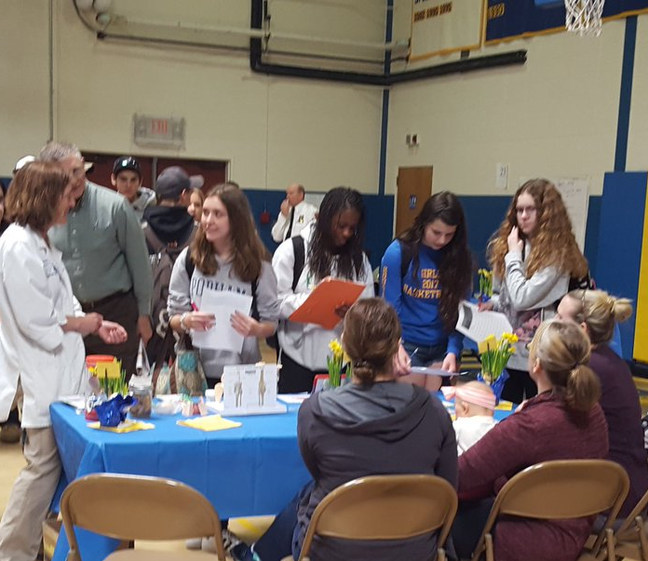
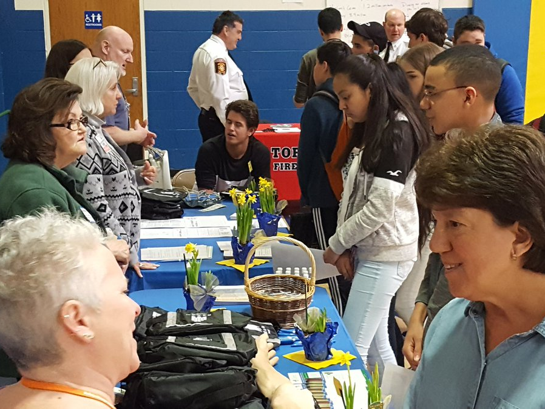
Career Fair
Tyler Burdick and Robin Beaujon
organized over 40 community members
to speak with students about
their professions.

Slide 4
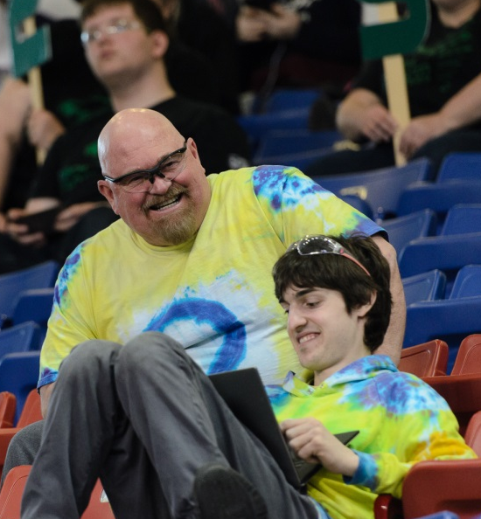
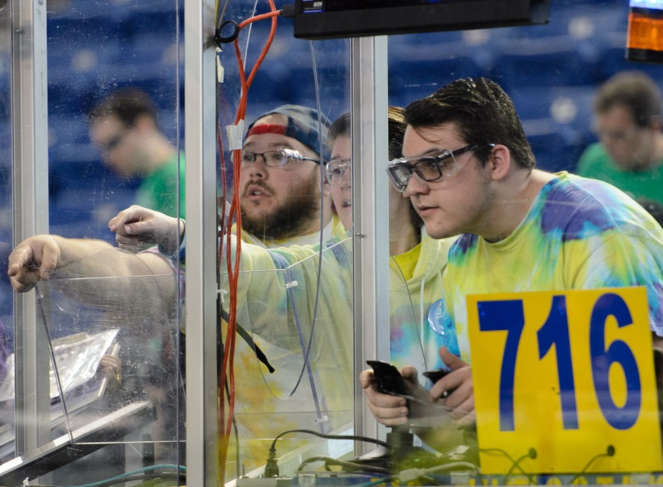
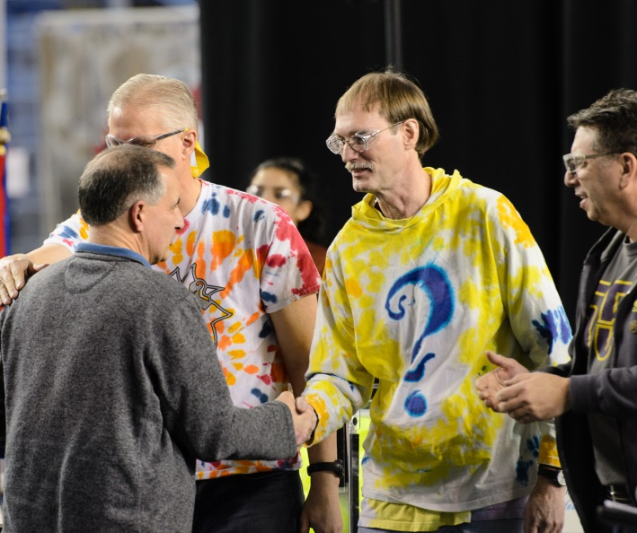
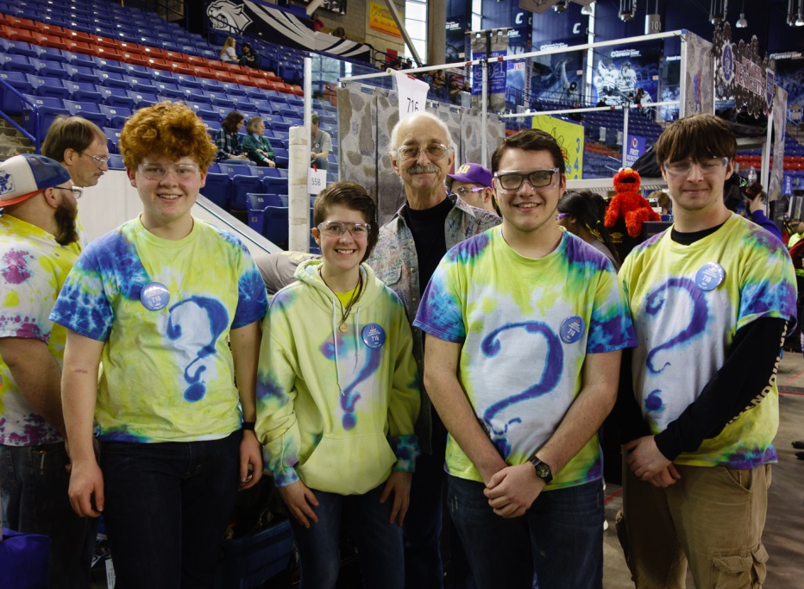
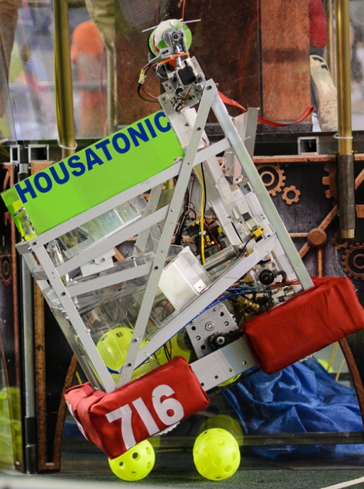
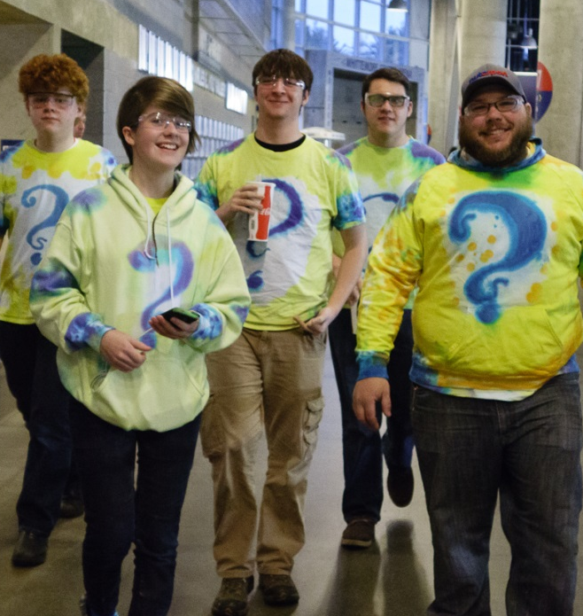
FIRST District Championship

Slide 5
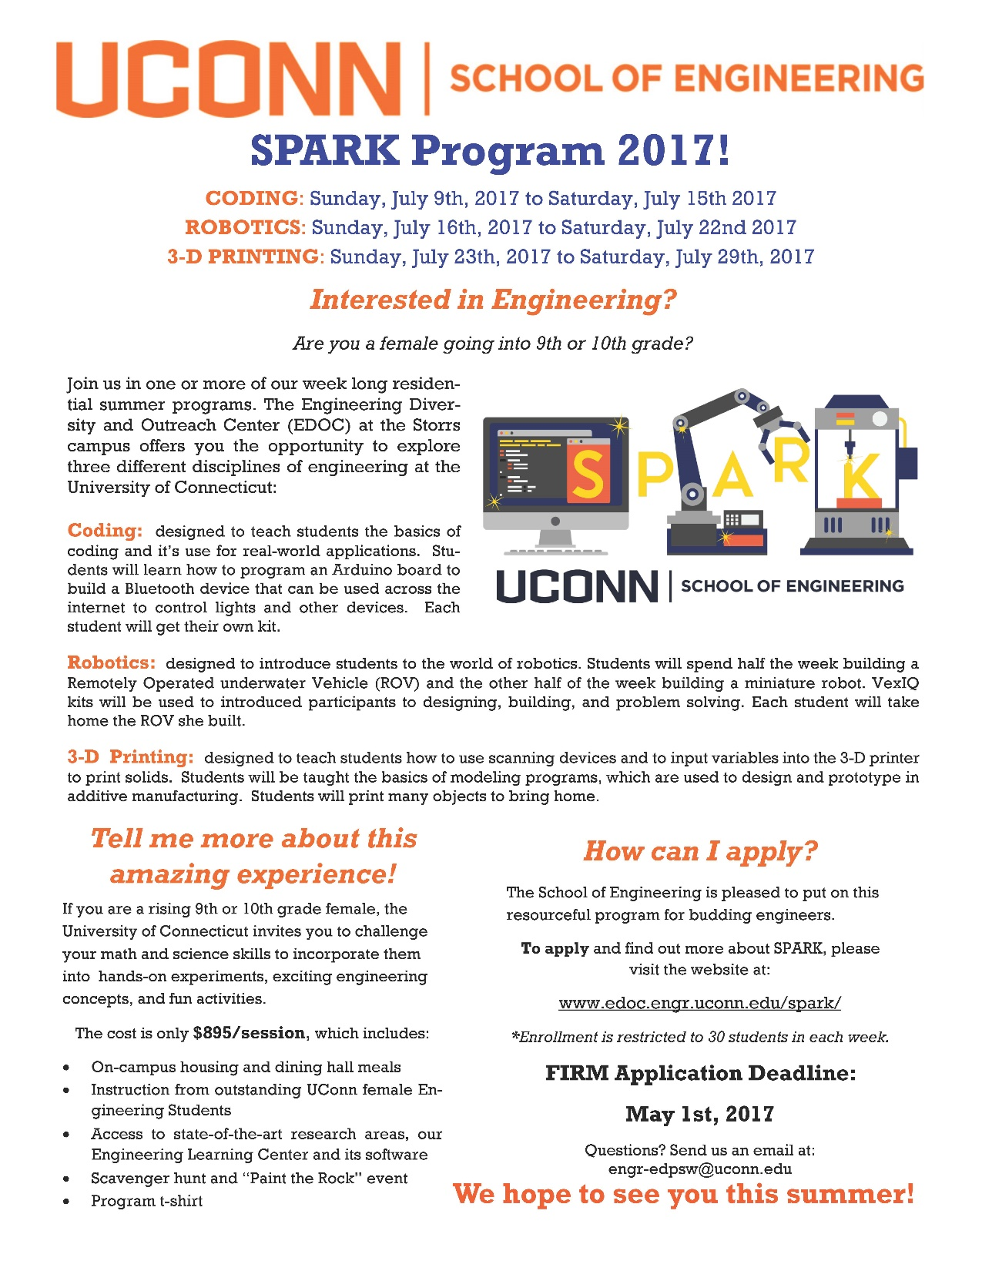
Building Bridges to UCONN Kia Huggan, HVRHS alum and UCONN Freshman, is on SPARK planning committee

Slide 6
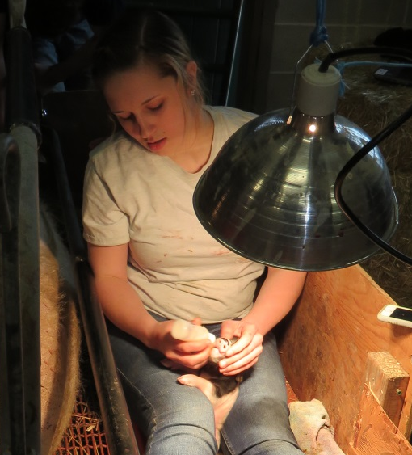
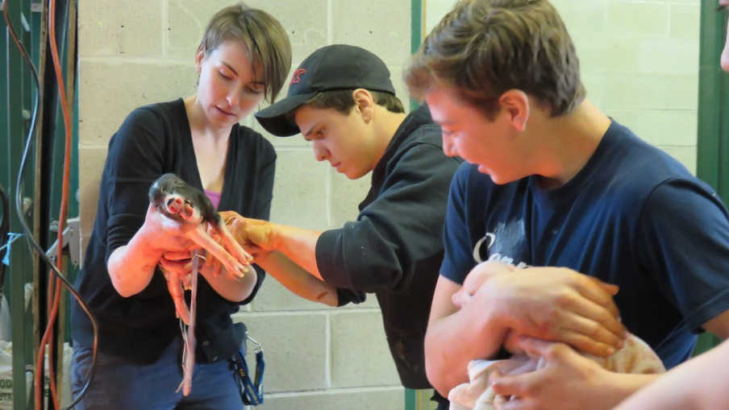
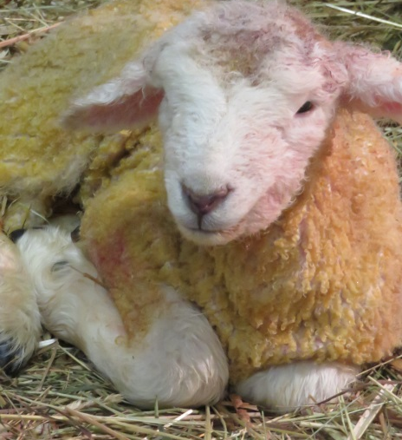
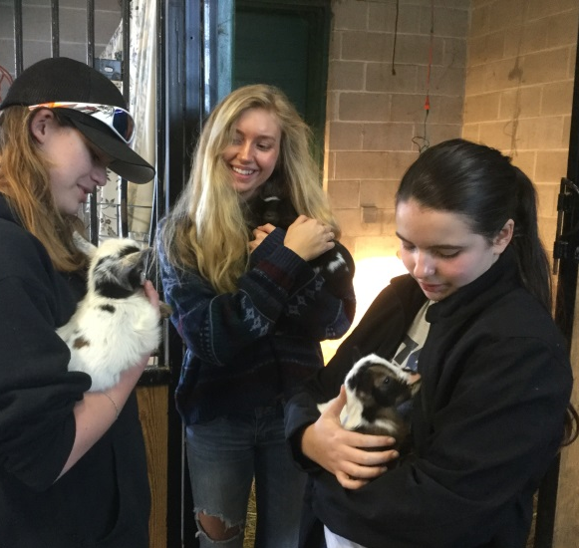
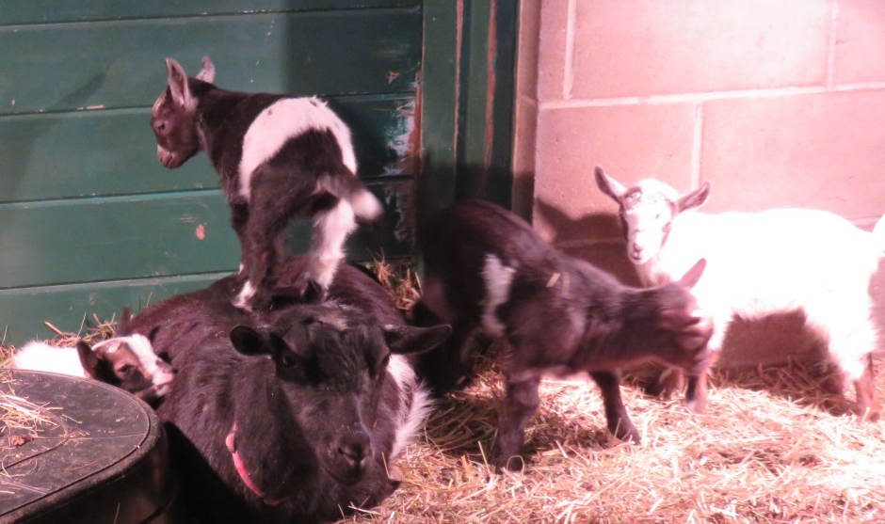
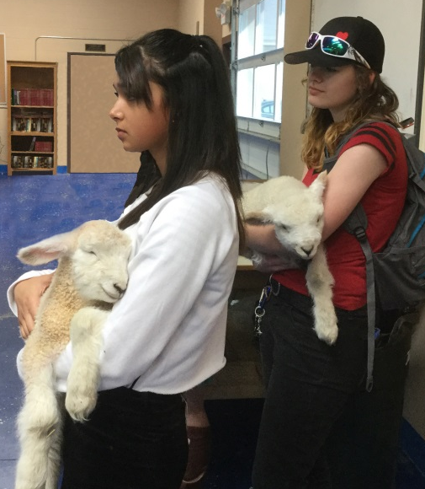
Spring at AG ED Barn

Slide 7
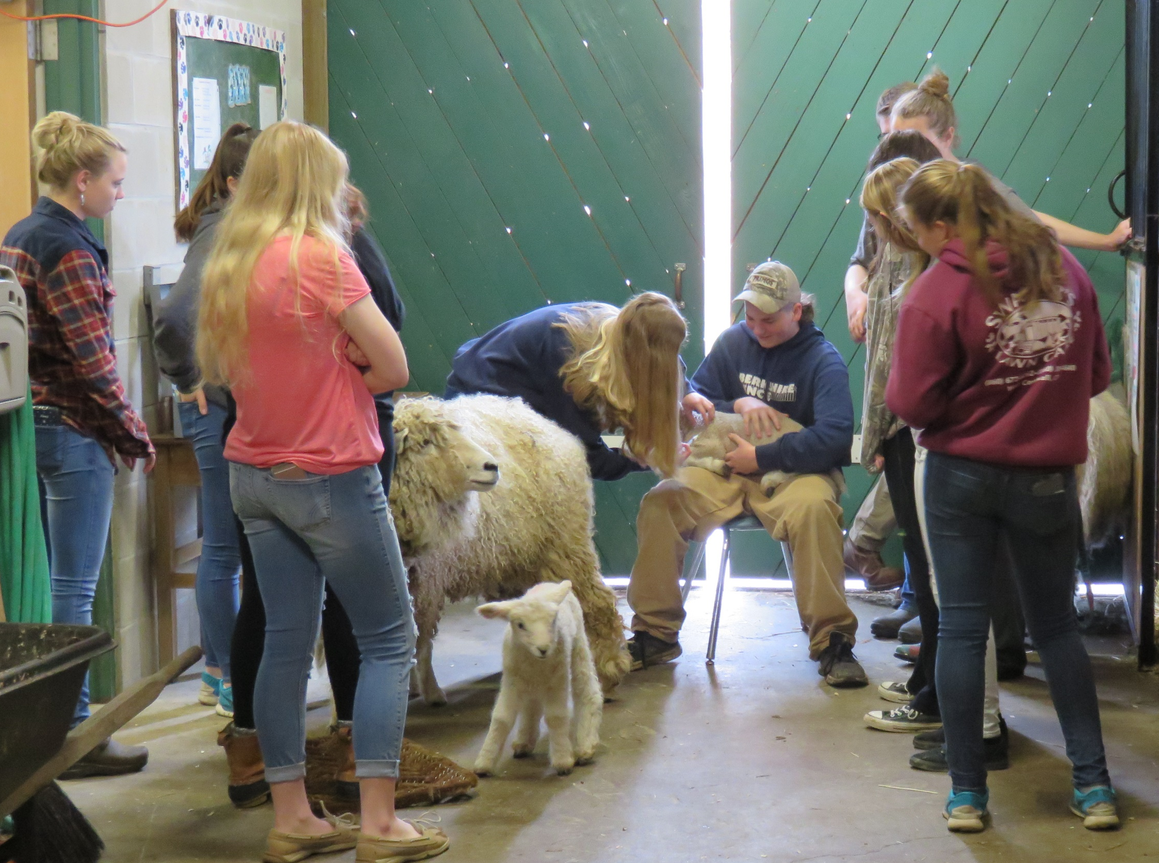
Learning How to Care
For Animals

Slide 8
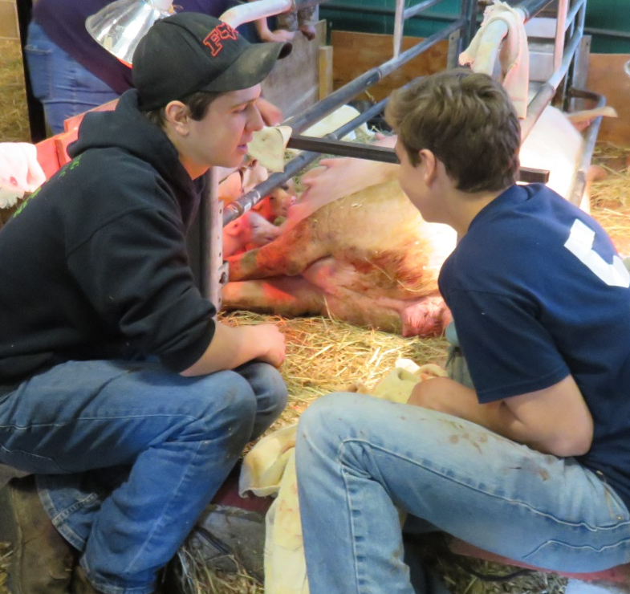
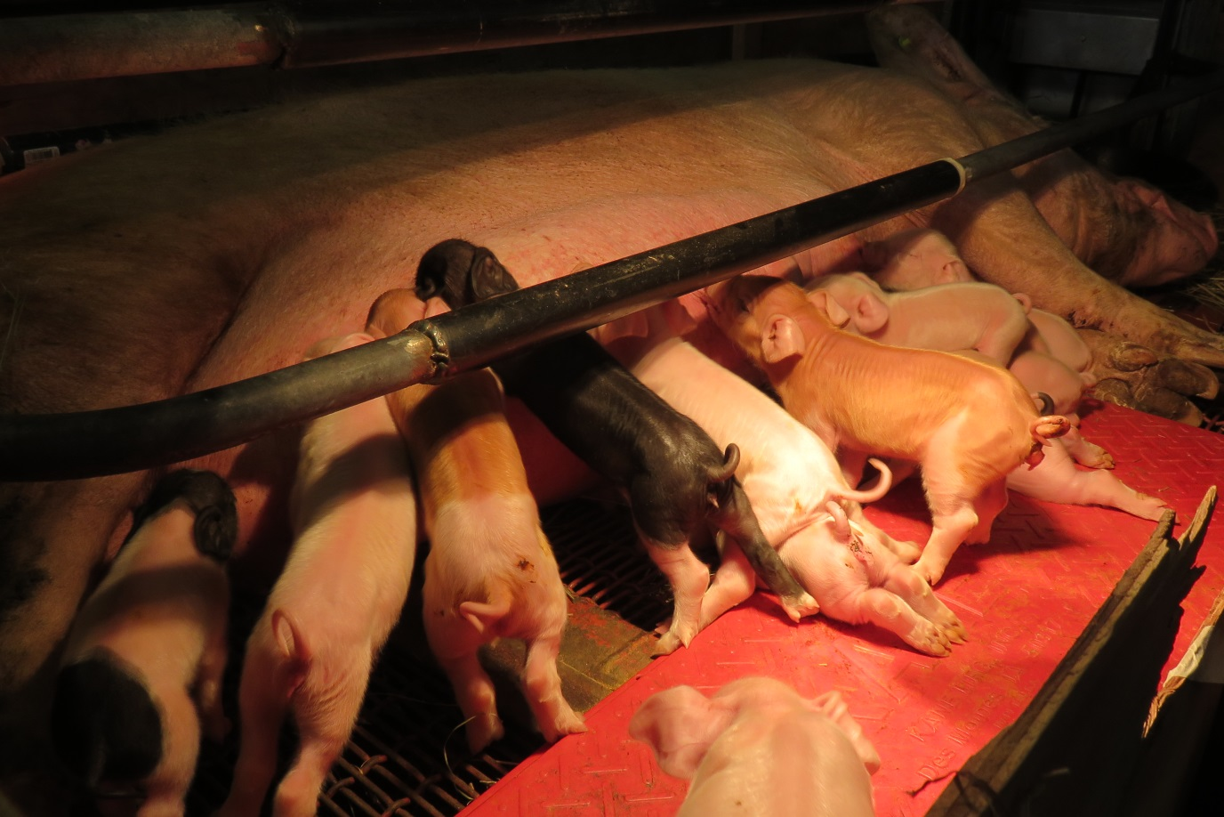
Ben Soper & Patrick Alexander
(class of ’18)
Brought their sow to school
Her fourteen emerging piglets provided
an amazing “Show and Tell” for all of us

Slide 9
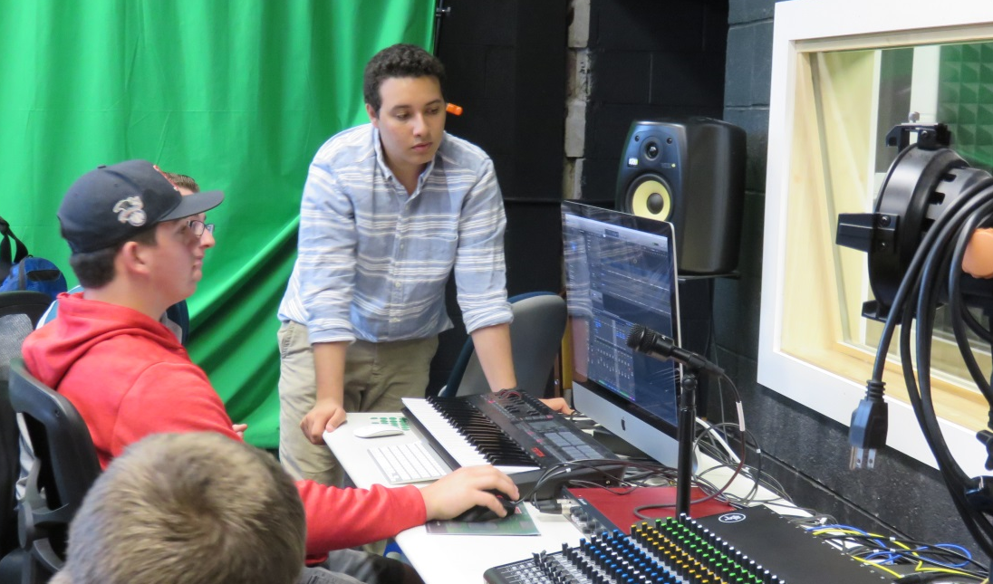
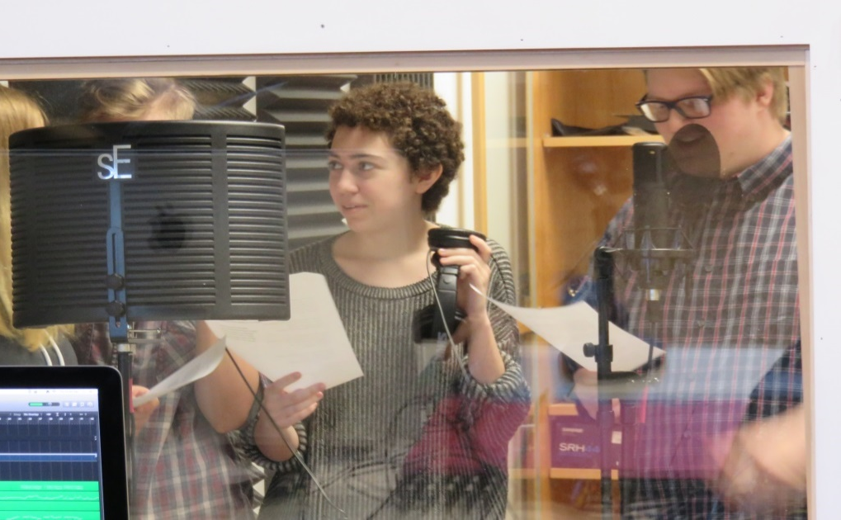
Mahoney-Hewat Studio
Hands-on-Music Classes
(Conceived by a Student Steering Committee
made possible by grants and Community Donors)
Music Tech
Chorus

Slide 10
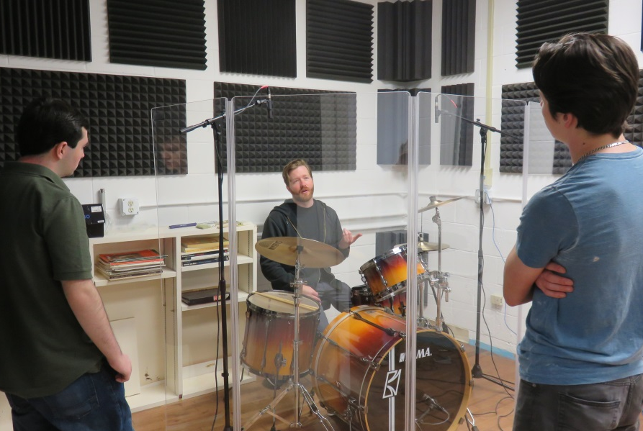
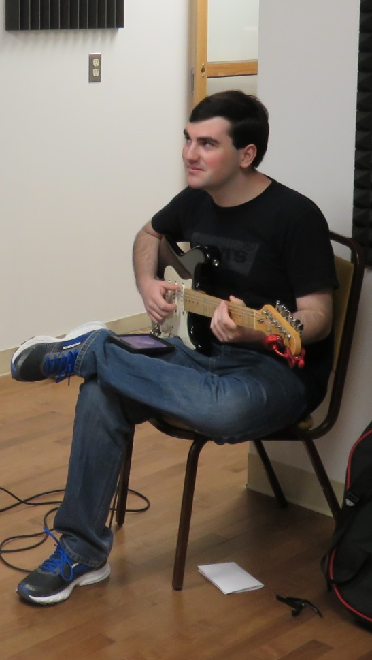
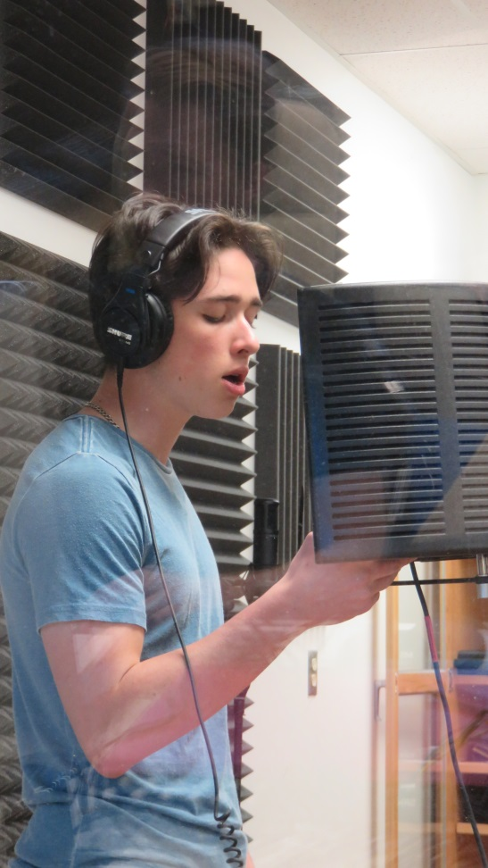
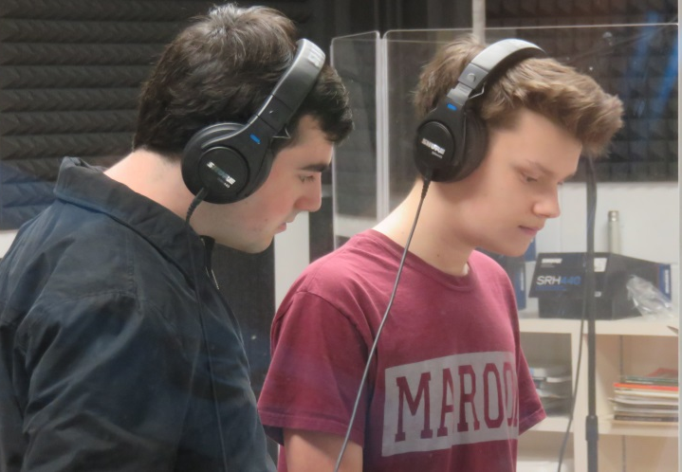
Spring Break Workshop
w/profession Sound Engineer

Slide 11
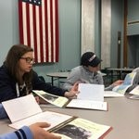
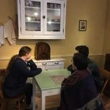
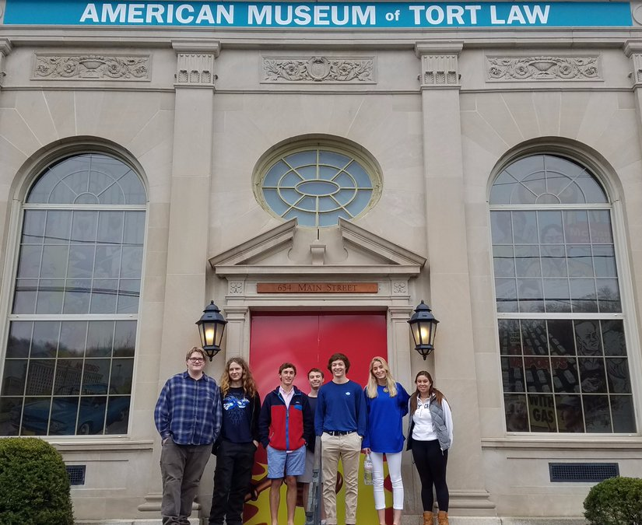
Regional Experiences
FDR Library
Tort Museum
These are just a few of the field trips our students participate in.

Slide 12
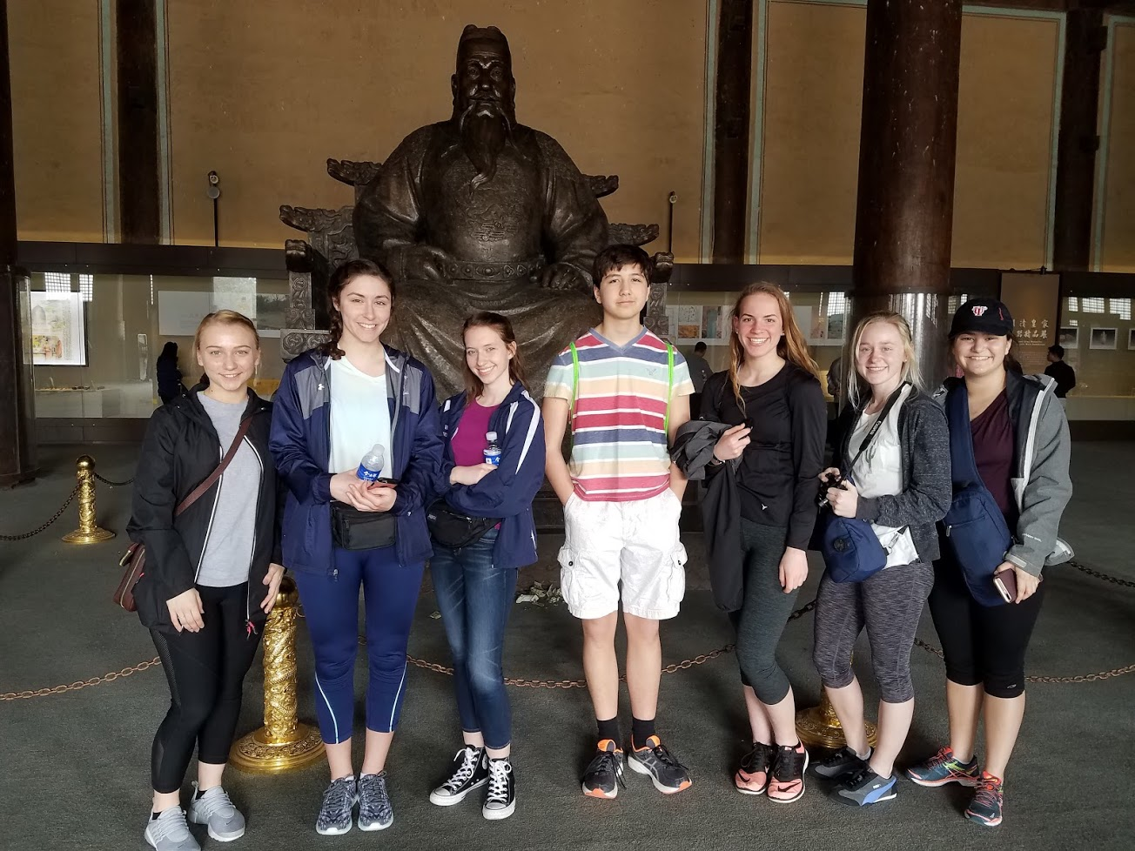
Foreign Travel
China 2017

Slide 13
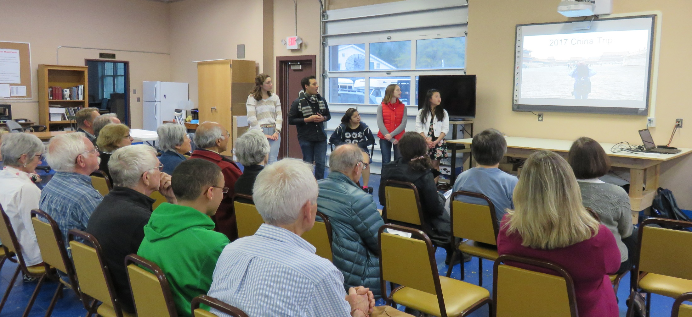

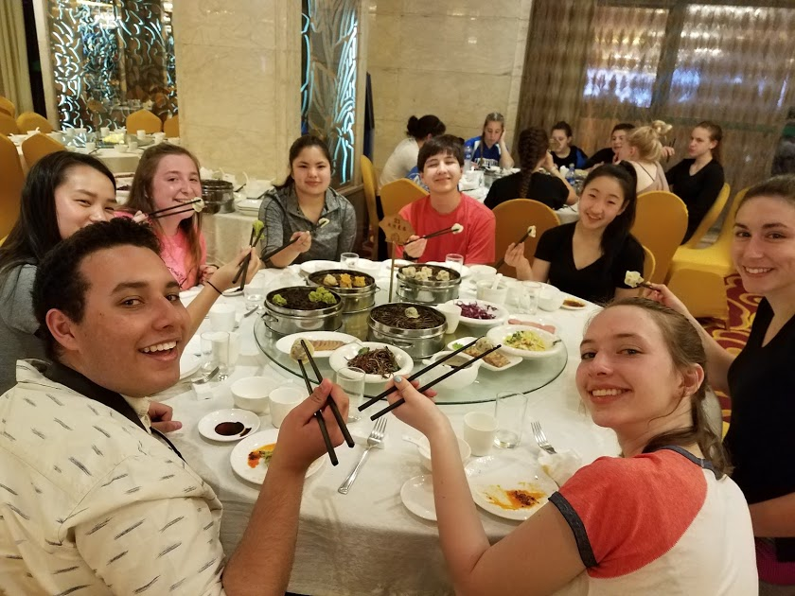
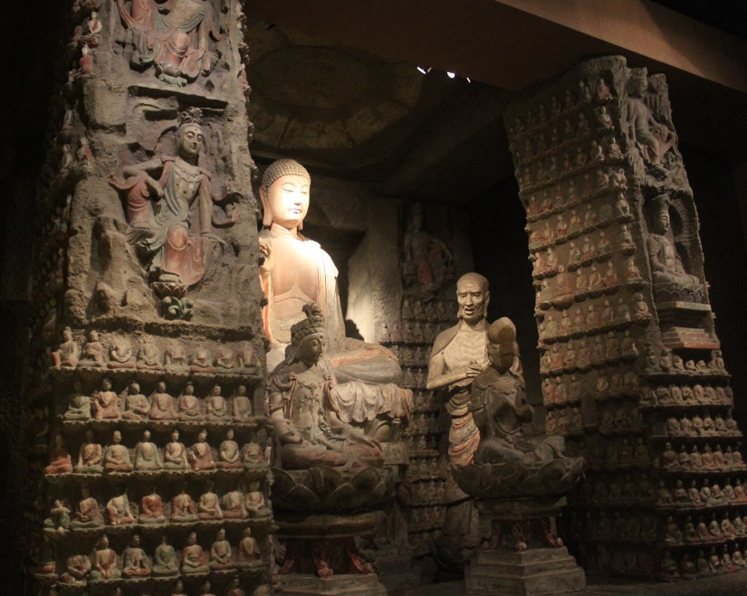
Sharing their Stories

Slide 14
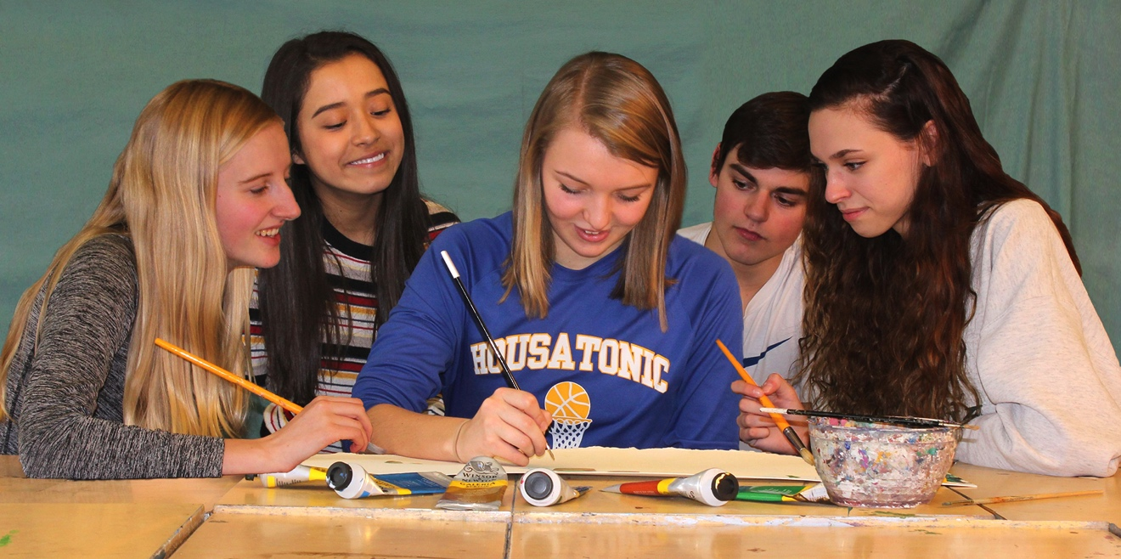
Creativity thrives at HVRHS Art Department

Slide 15

2017 Blue & Gold Show at the White Gallery
Invitation postcard designed by
Johanna Spencer, Class of 2017

Slide 16
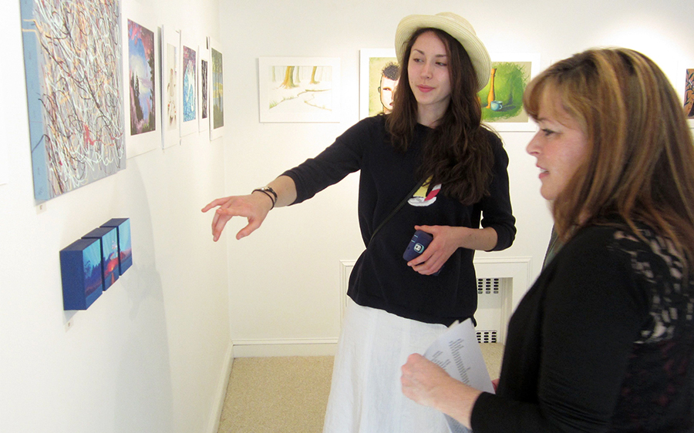
2017 Blue & Gold Show at the White Gallery May 19-21 Opening Reception May 19th, 5 – 7 PM
Over sixty pieces of art in a variety of mediums including acrylic, watercolor, pastel, monoprint, photography, sculpture, drawing and animation.

Slide 17

2017 Blue & Gold @ The White Includes The Sharon Woman’s Club Annual Benefit for HVRHS Art Program!
The winner of SWC’s raffle for a hand painted chair will be picked at the Blue & Gold opening. The benefits go towards student scholarships.

Slide 18
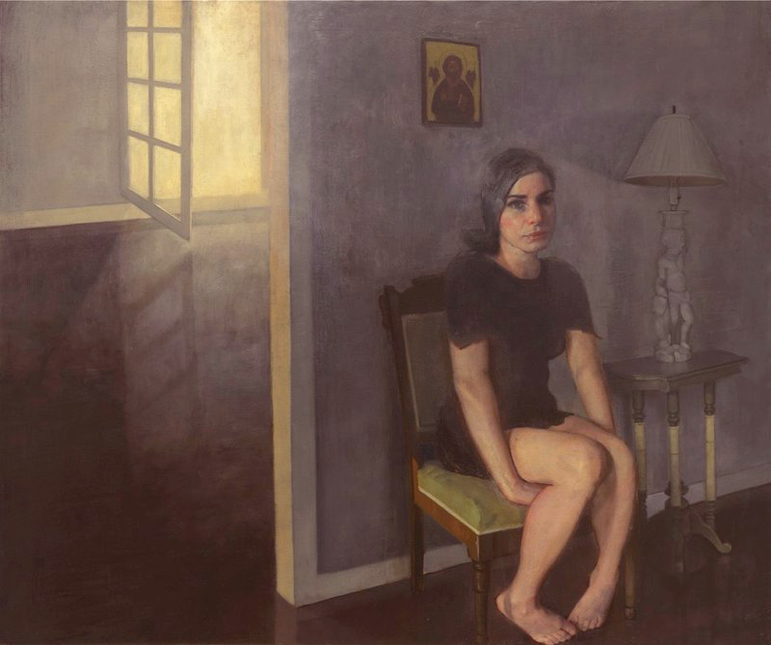
New exhibit in Library features work from Paris!
Invitation postcard designed by
Johanna Spencer, Class of 2017

Slide 19
Richard T. Scott
Current exhibit in Library
The exhibit, “Poetics” features Richard T. Scott’s sketches, oil studies, drawings and prints.
Mr. Scott, a Georgia native, is considered one of America’s leading exponents of the post-contemporary figurative art movement. He was named one of 25 Artists of the Future by American Art Magazine. He received his art training in NYC, Paris and Oslo. He exhibits internationally.

Slide 20
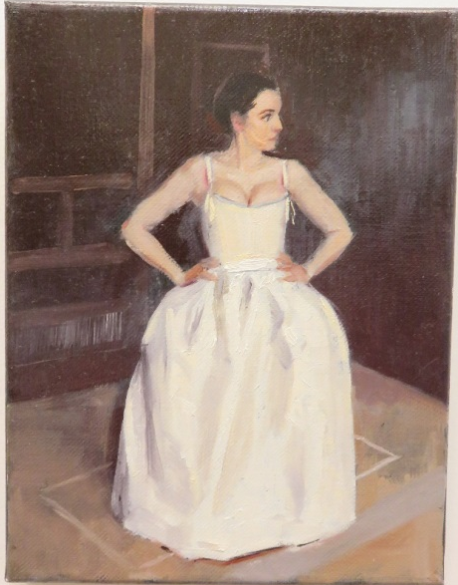
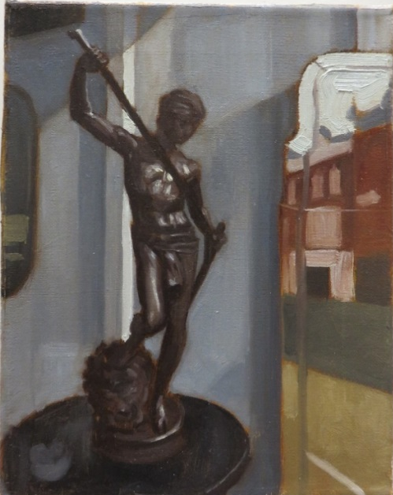
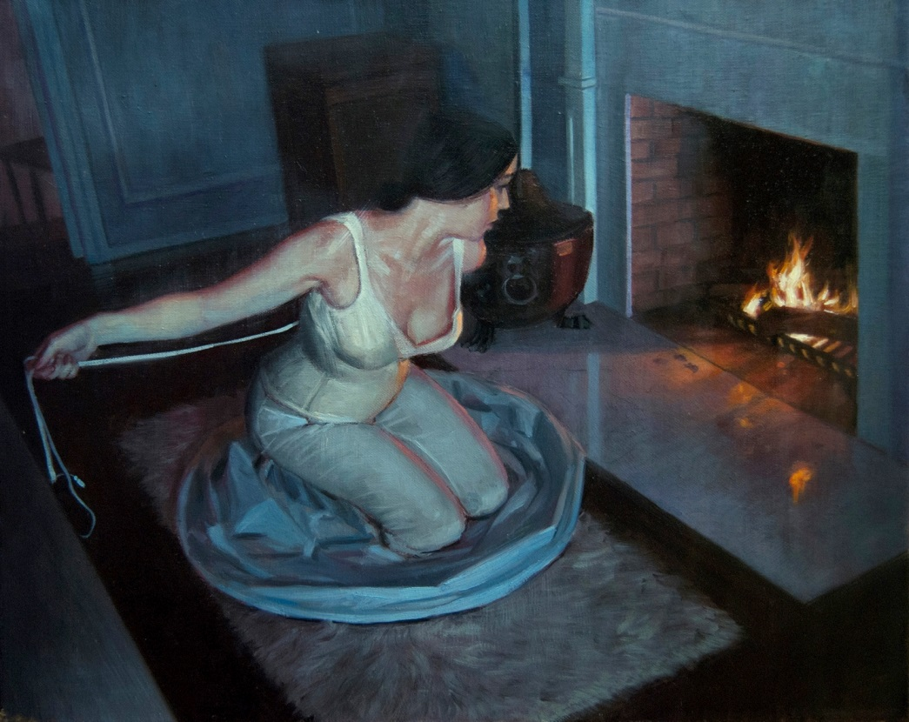
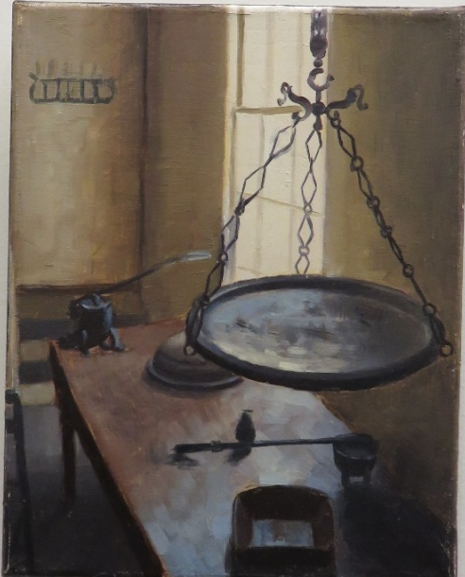
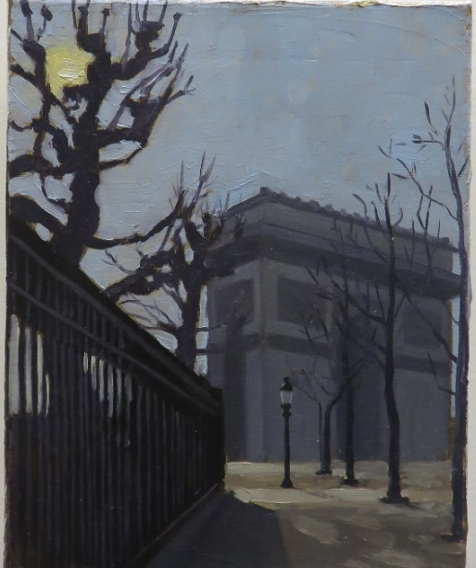
Richard T. Scott
Selected works

Slide 21
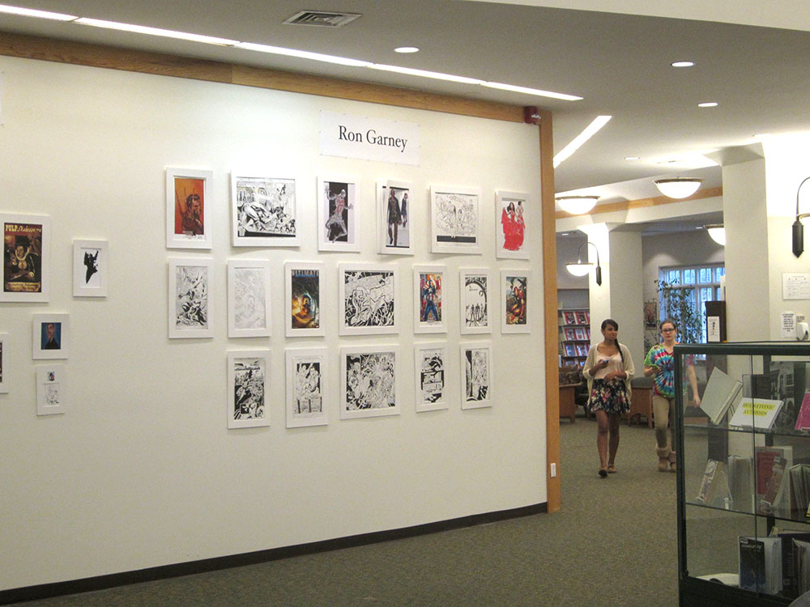
HVRHS Fine Arts Society Launches Art Internship Program
Gallery interns
Ella Matsudaira,
Tianna Togninalli,
Bethany Conti and Emelia Luz are responsible for maintaining the gallery and working directly with exhibiting artists on designing and hanging each show. These experiences prepare our young artists for a lift in the arts.

Slide 22

The Contemporary Visual Arts Scholarship announces this year’s applicants.
The annual CVAS scholarship will be awarding $40,000 to a talented senior. One requirement: A letter of acceptance from an accredited 4 year art school / art program.
This year’s applicants are Johanna Spencer,
Maggie Sullivan and
Emily Sullivan.
Digital Self Portrait by Lizzie Riccardelli, CVAS recipient currently attending Savannah College of Art & Design

Slide 23
Other Upcoming Art Events
• Professional artists Scott Bricher and Ed Martinez will be conducting a portrait painting demo to art students in late May.
• Applications are being accepted for a valuable summer figurative art seminar. Artist Daniel Howe will be returning for his second year of working with gifted HVRHS art students.
•HVRHS Student work will be competing for a spot in the next CABE exhibit: The Connecticut Association of Boards of Education. The exhibit will be held in Wethersfield, CT.

Slide 24
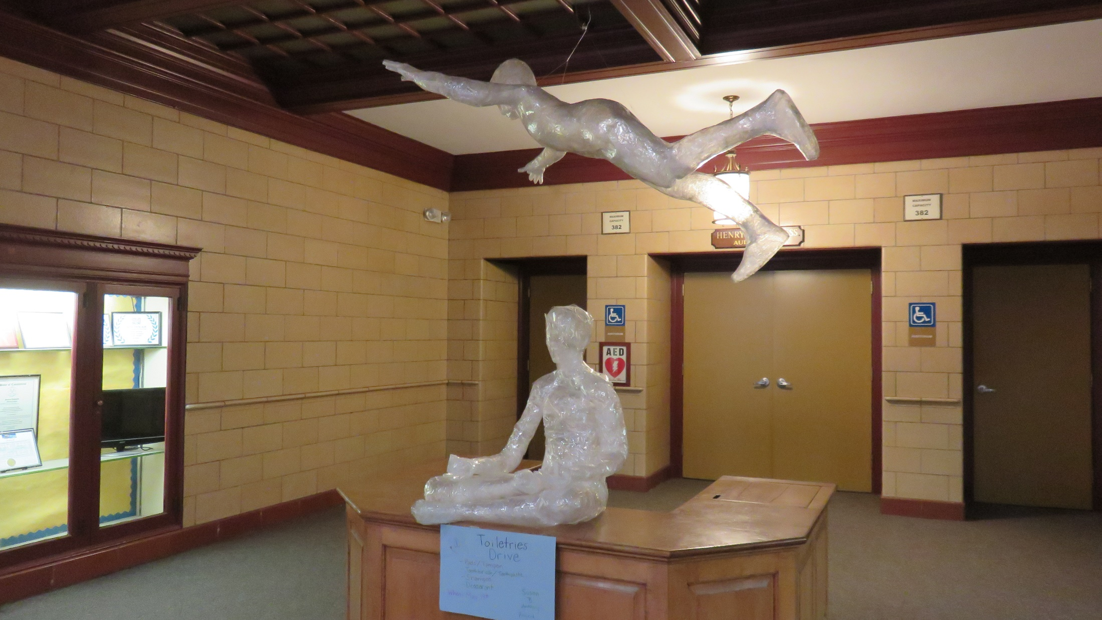
Student Sculptures on Campus

Slide 25
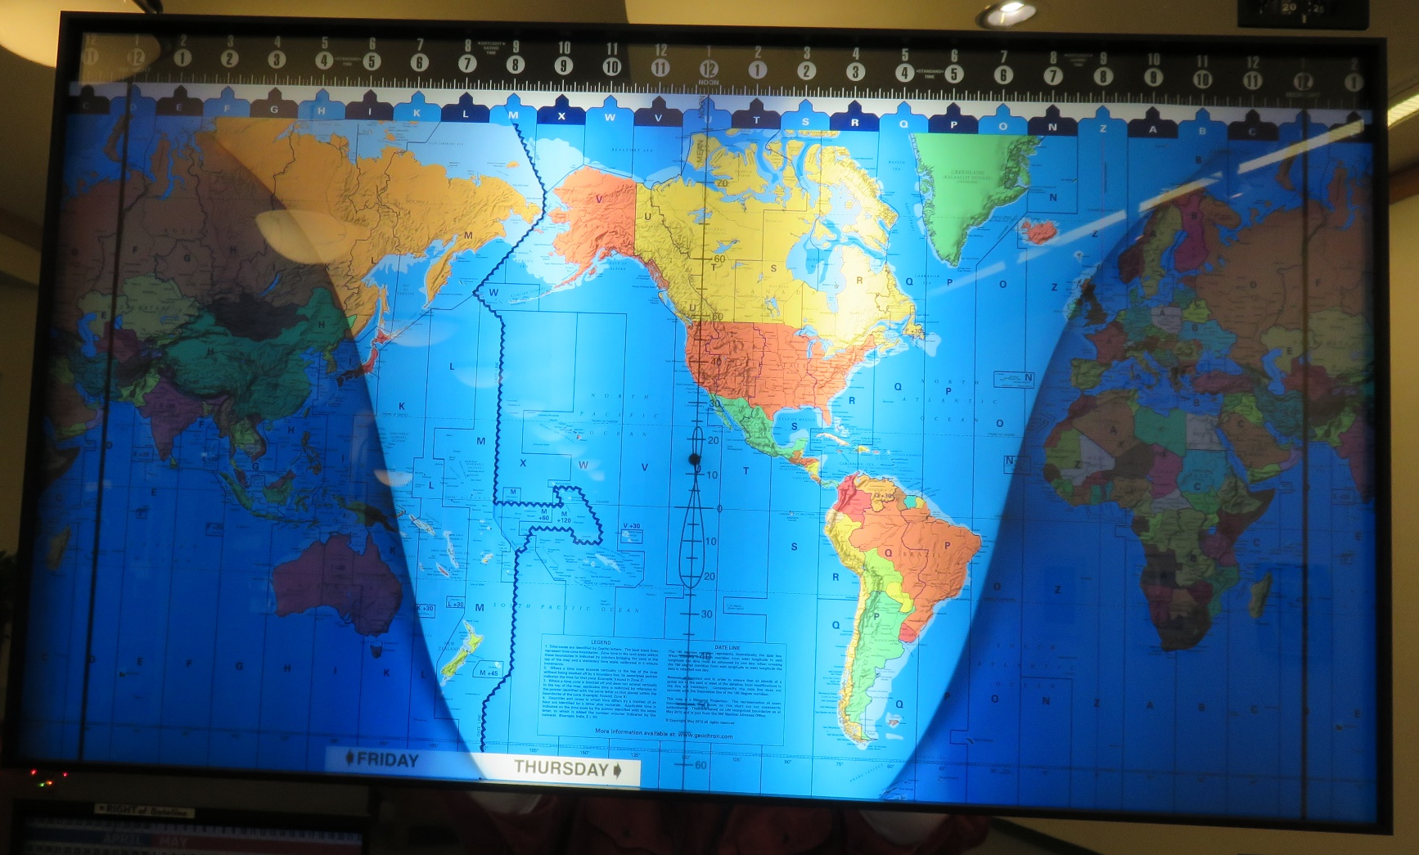
GEOCHRON On Display in Library

Slide 26
Alumni Wall of Honor
The HVRHS Alumni Association is creating an Alumni Wall of Honor (WOH) in the main lobby of the school; it will consist of plaques and a multi-media video.
The instillation will introduce students and the community to HVRHS graduates who have embodied the core values of Housatonic Valley Regional High School and have exemplified those values in their life’s work. Details at:
www.hvrhs.org/alumni/alumnialumni-wall-of-honor/

Slide 27


Slide 28


Slide 29
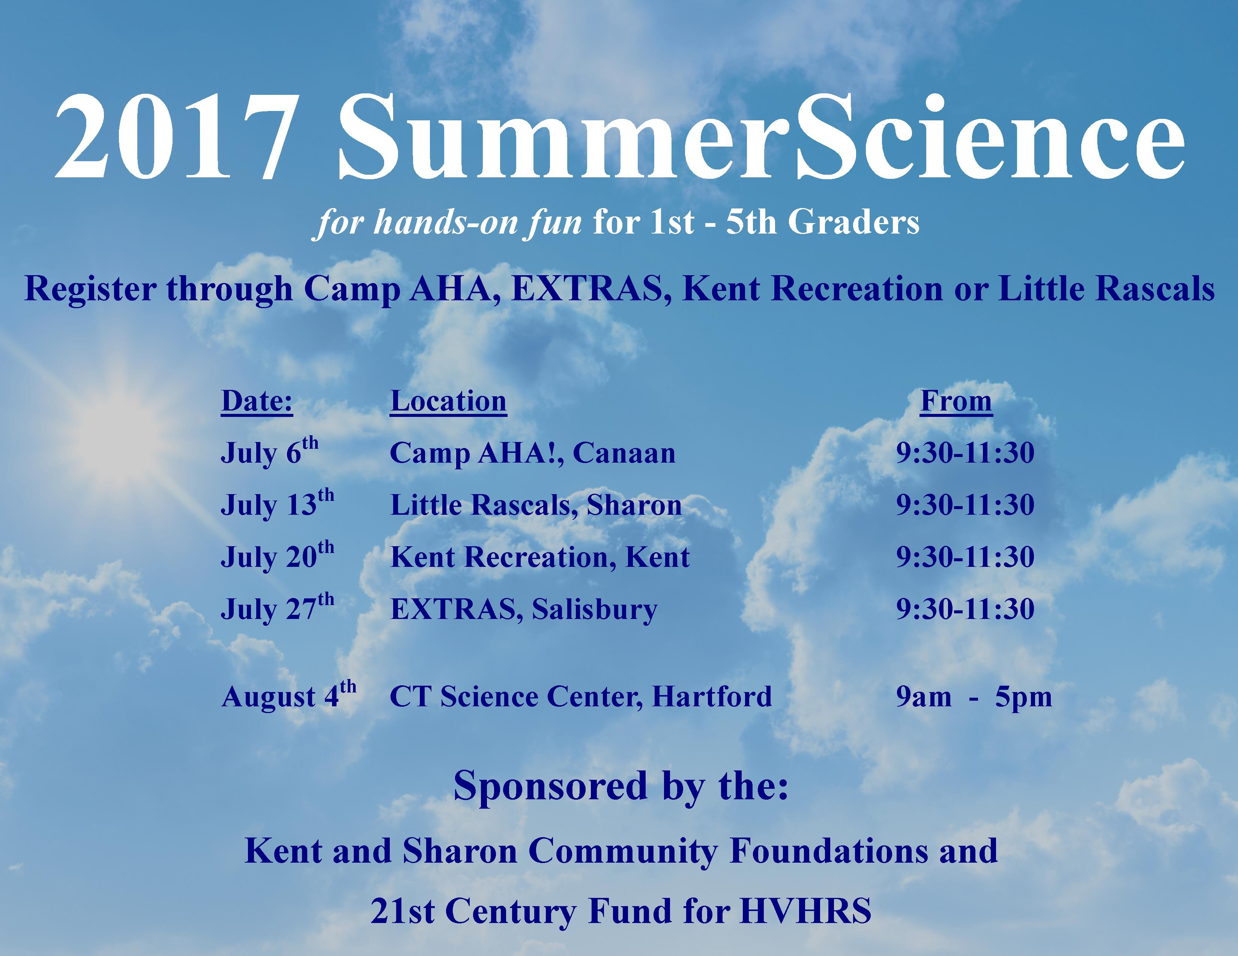

Slide 30


